Slide 1
Malnutrition State/Local Advocacy
Defeat Malnutrition Today
May 30, 2019

Slide 3
About the Coalition
Coalition of over 90 national, state, and local stakeholders and organizations, including community, healthy aging, nutrition, advocacy, healthcare professional, faith-based, and private sector groups
Share the goal of achieving the recognition of malnutrition as a key indicator and vital sign of older adult health risk; work to create policy change toward a greater emphasis on screening, detecting, treating and preventing malnutrition

Slide 4
Resources
The coalition has curated a number of resources and infographics on our website and elsewhere, including:
National Blueprint: Achieving Quality Malnutrition Care for Older Adults
State Legislative Toolkit
Infographics for the Blueprint and Toolkit and on “malnutrition 101”
Articles detailing the issue of malnutrition, including on the ICAA blog
Studies on malnutrition
Links to other resource hubs and publications

Slide 6
What’s Happening Now in the US?
The National Conference of State Legislatures passed a resolution supporting malnutrition prevention and awareness in their official platform
Partially as a result, key states are taking action (MA, OH, VA, CT, NM, ME) and interest is building in other states (FL, WA, PA, TX and potentially others)

Slide 7
Examples of Statewide Activity
Some examples:
In MA, a Malnutrition Prevention Commission was formed and completed its first year report; also just had Malnutrition Prevention Week with more than 75 participating sites statewide
In OH, an MPC was formed and has now completed its final report
In VA, after legislation passed, the pre-existing Commonwealth Council on Aging has integrated malnutrition prevention into its duties
You’ll learn about NM and PA in a moment

Slide 9
Malnutrition Legislation in New Mexico
Stephanie Rogus
Public Policy Coordinator, NM Academy of Nutrition and Dietetics
May 30, 2019

Slide 10
New Mexico and Malnutrition
In 2015, 9% of New Mexican mothers reported eating less than they should due to financial hardship.
From 2014-2016, 8.8% of infants were born with low birth weight.
More than 38% New Mexico children live in households that receive income and food assistance.
In 2015, USDA Food Atlas reported that 135 of 499 New Mexican census tracts are food deserts
Food insecurity impacts 25% of New Mexican children.
Nearly 27% of New Mexico’s 2.1 million residents are over the age of 65.

Slide 11
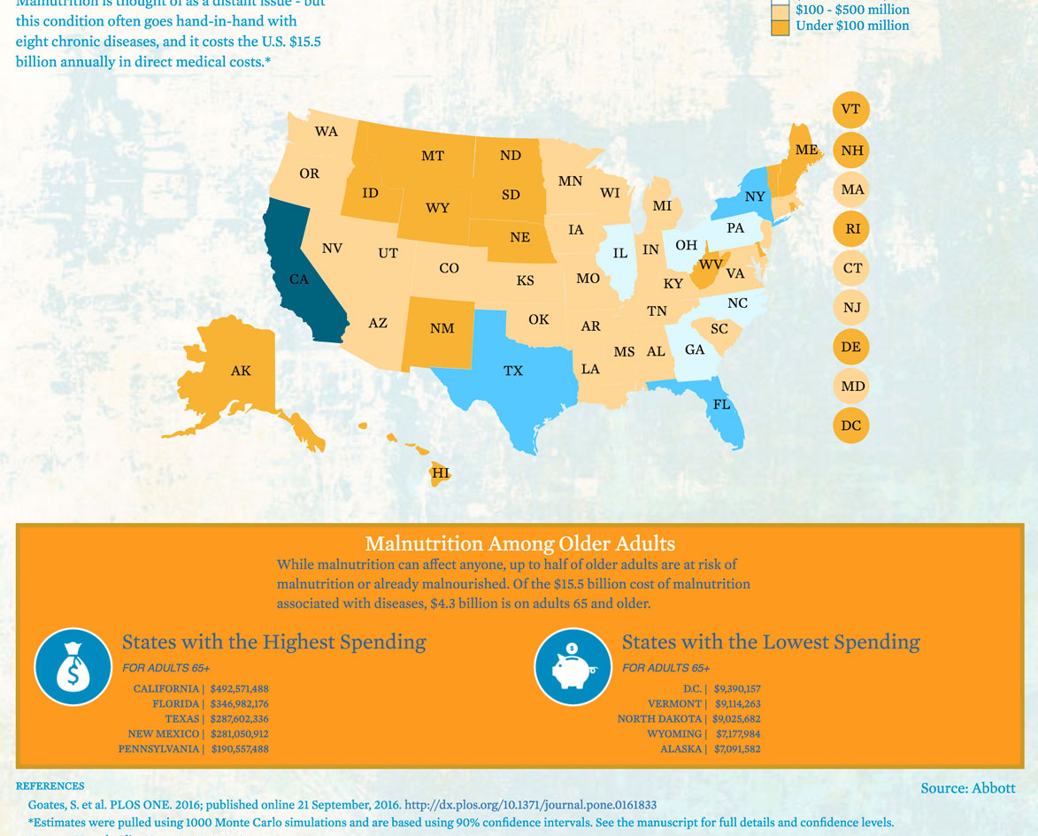
New Mexico Economic Impact
Spends more than $28.9 million on malnutrition related costs.
Ranks 4th out of 5 of the highest spending states:
California
Florida
Texas
New Mexico
Pennsylvania

Slide 12
Legislation Beginnings
Academy of Nutrition and Dietetics 2018 Public Policy Workshop (DC)
Focus on malnutrition
Discussions within the New Mexico affiliate about state-level advocacy
Partnered with Abbott to get a bill introduced in the NM Legislature

Slide 13
New Mexico’s 54th Legislature
Dec 17, 2018 – Jan 11, 2019 Legislation may be prefiled
January 15, 2019 Opening day (Noon)
February 14, 2019 Deadline for bill introduction
March 16 , 2019 Session ends (Noon)

Slide 14
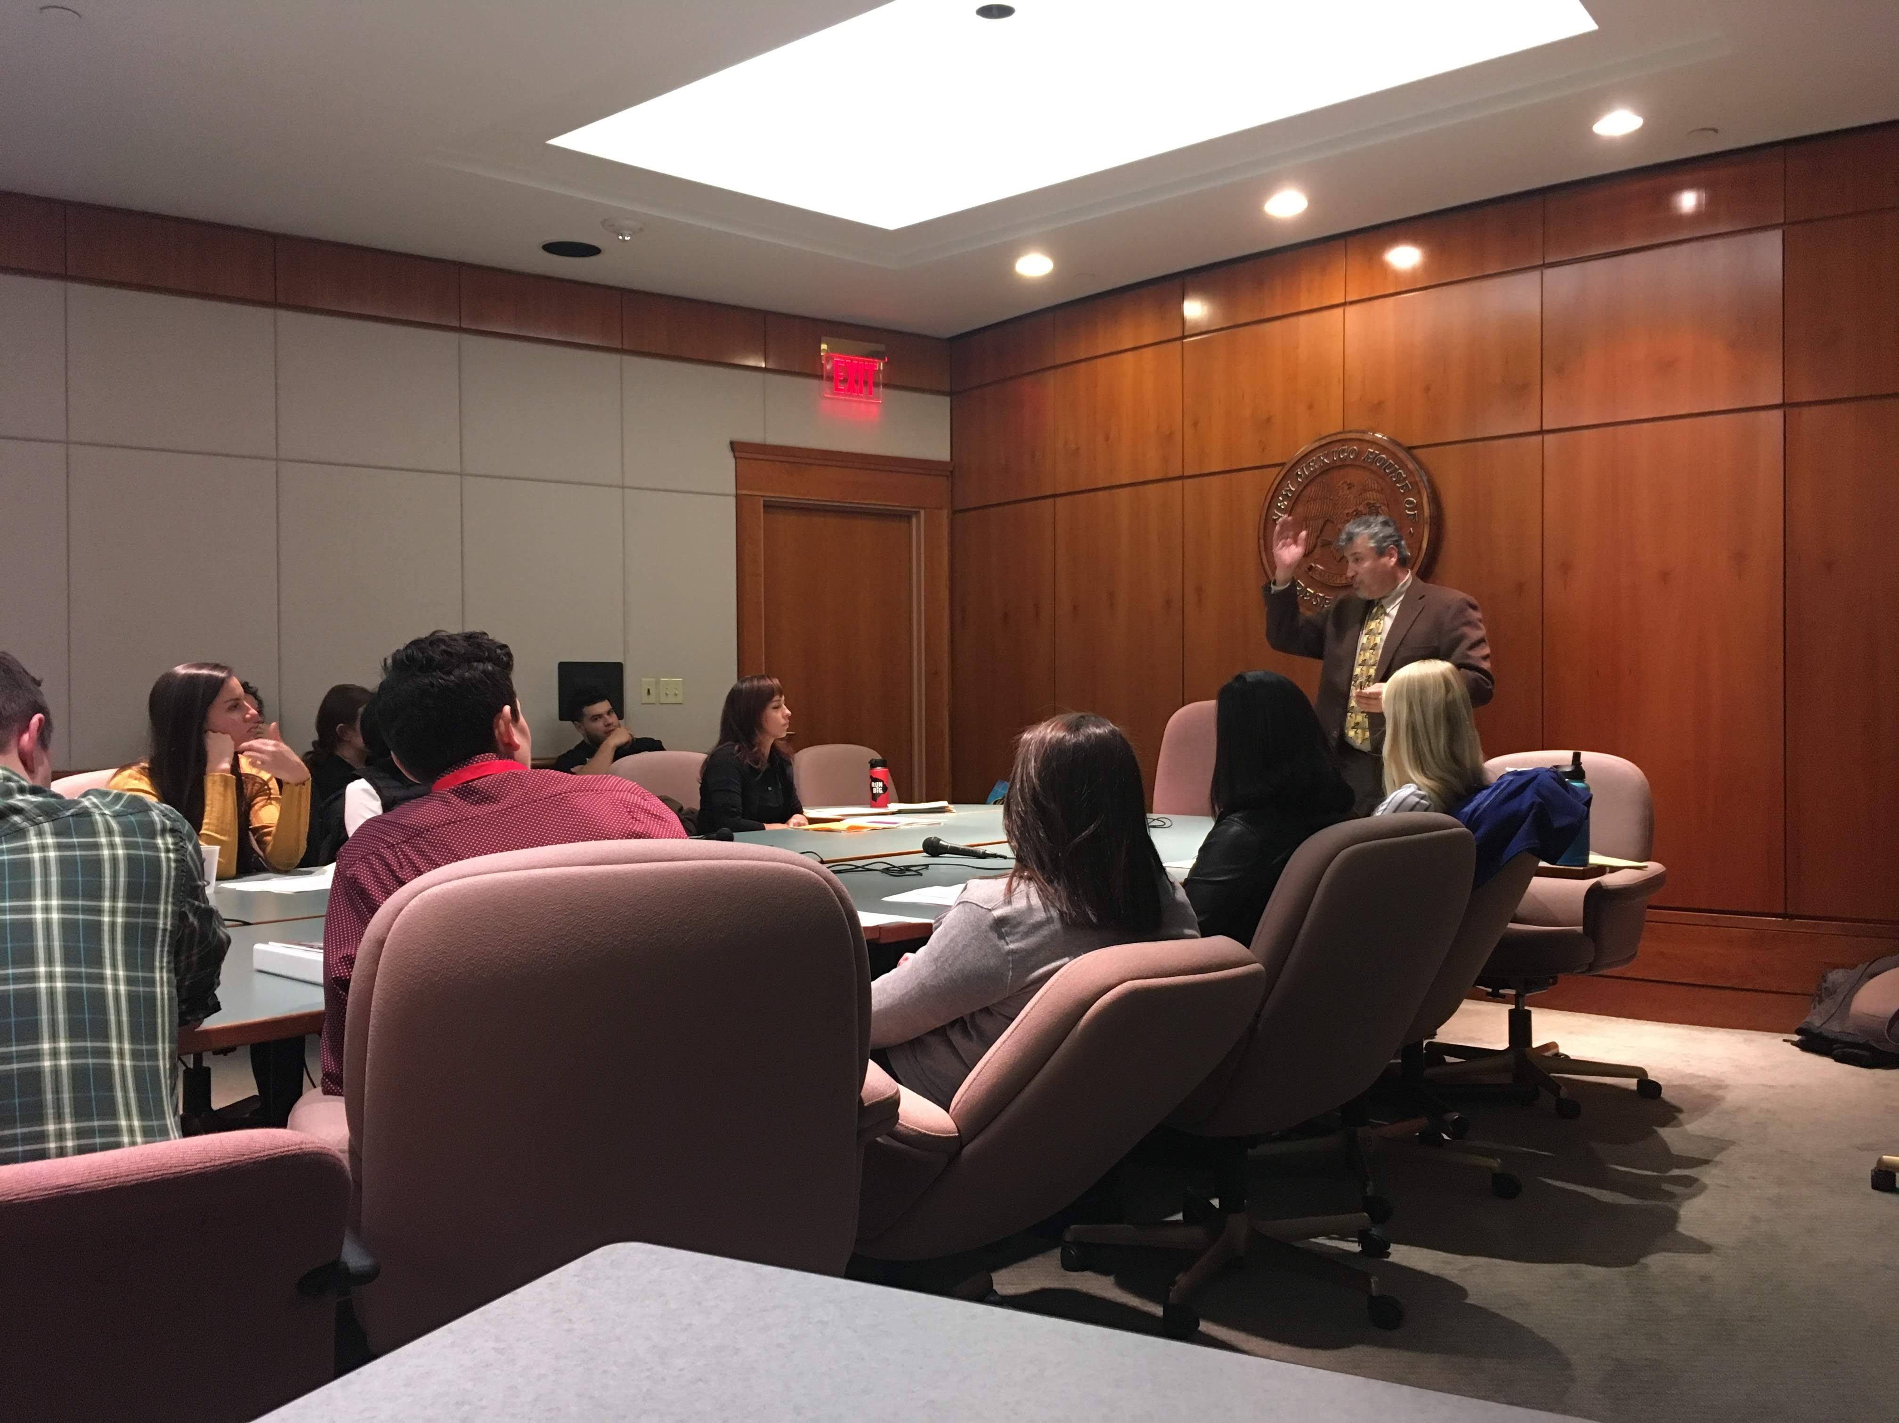
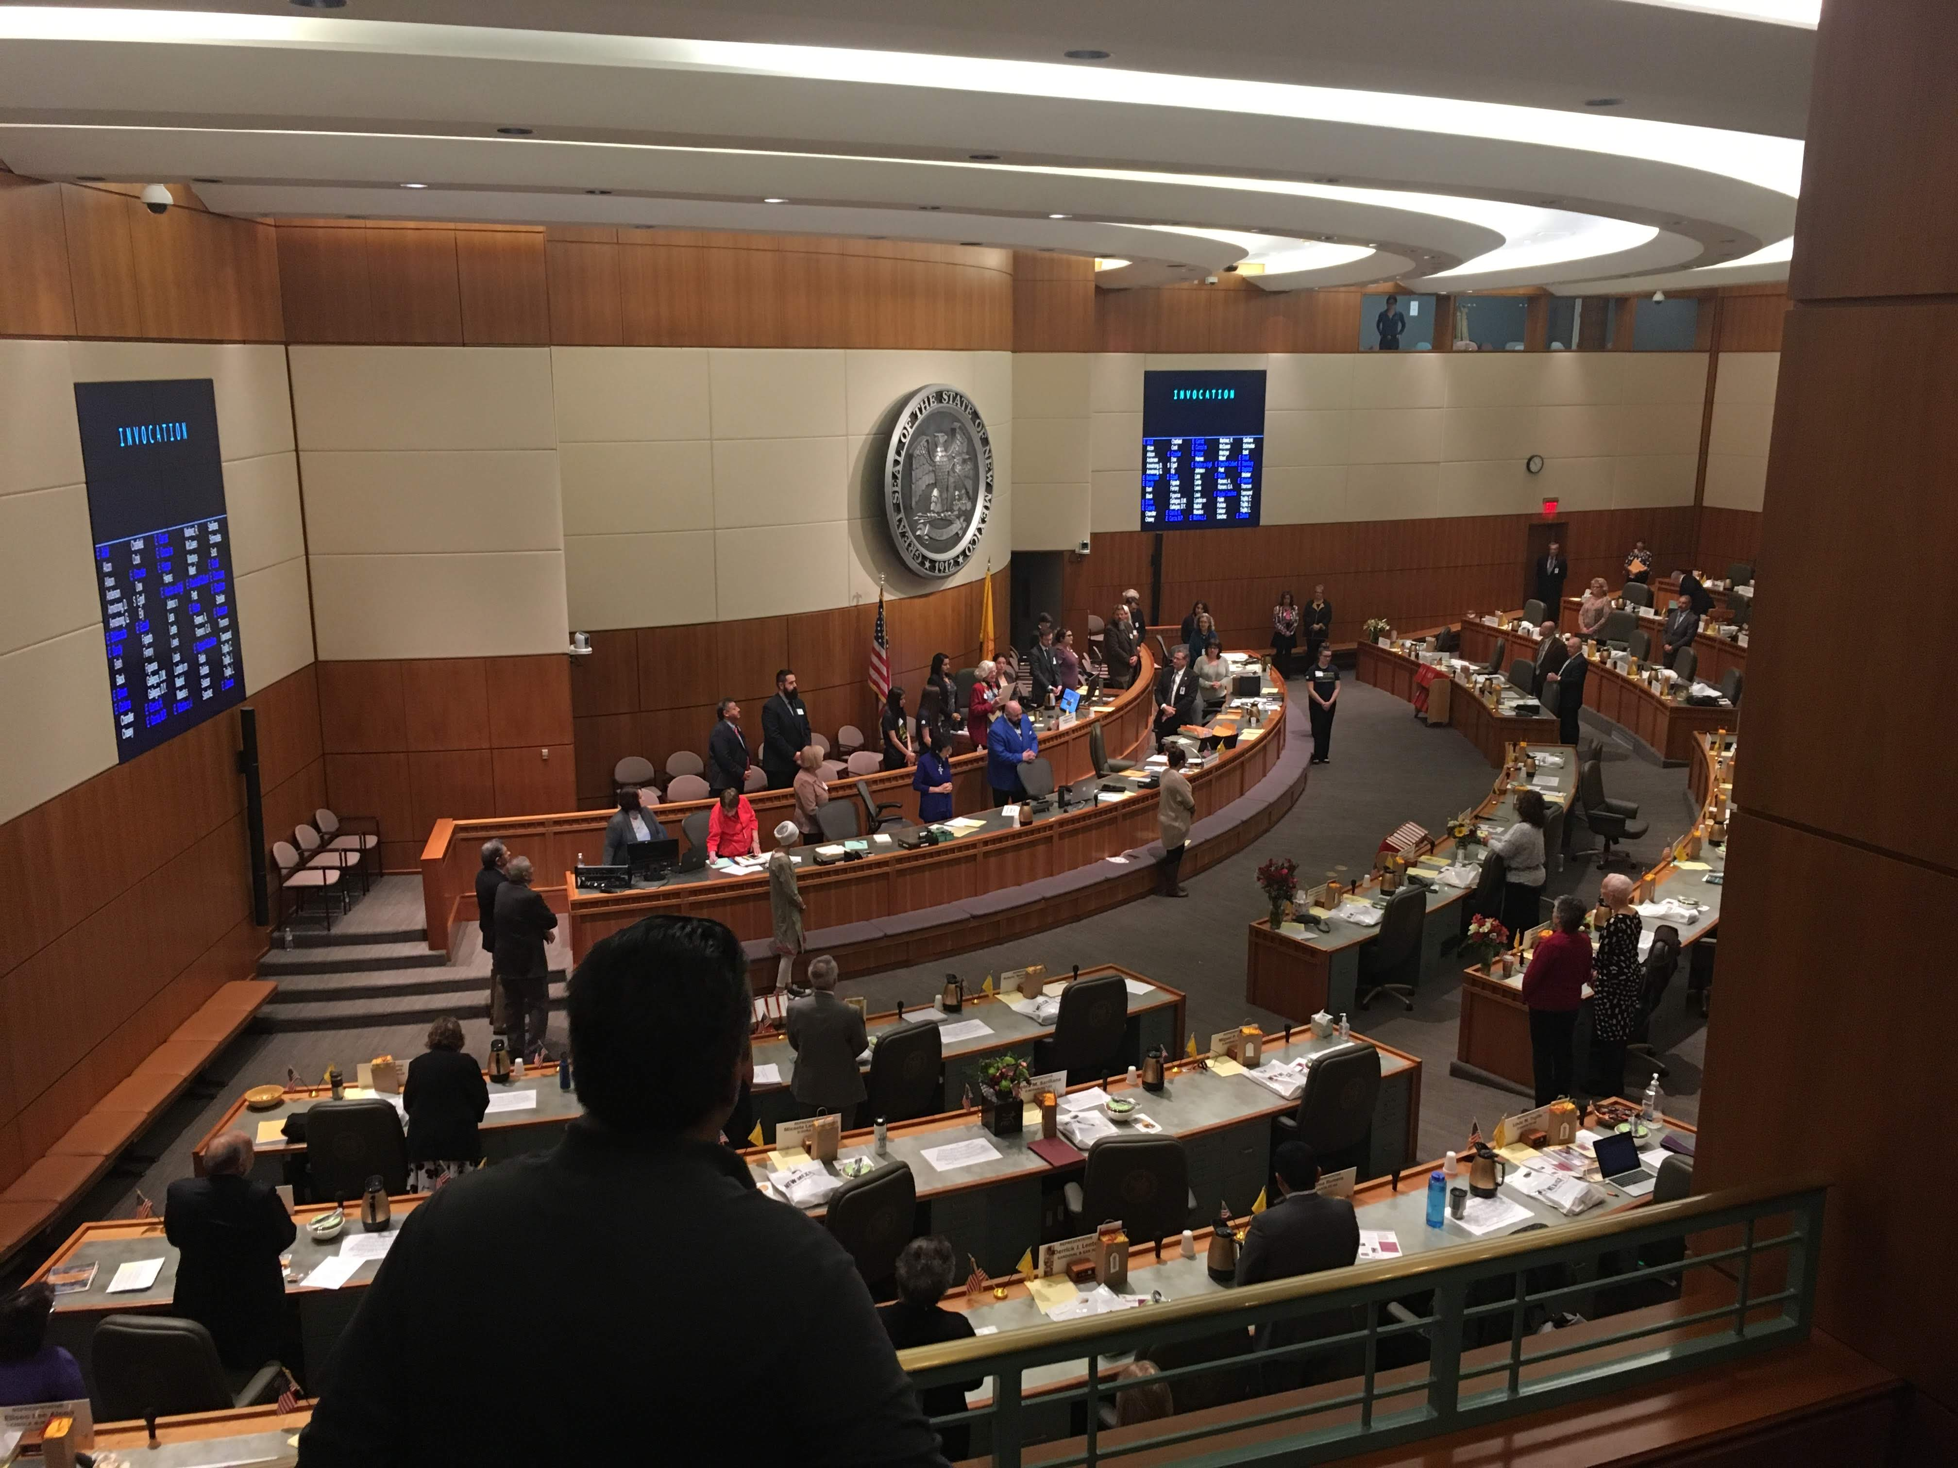
Legislative Day: January 24, 2019

Slide 15
New Mexico House Bill 466 (2019)
ESTABLISHES A MALNUTRITION COMMISSION TO STUDY THE IMPACT OF MALNUTRITION STATEWIDE AS IT RELATES TO HEALTH CARE, EDUCATION AND PREVENTION
Sponsors:
Representative Karen Bash
Representative William “Bill” Pratt
Representative Deborah Armstrong
Representative Joanne Ferrary
Representative Christine Trujillo

Slide 16
New Mexico HB 466
Department of Health
Department of Agriculture
Department of Human Services
Interagency Benefits Advisory Committee
Department of Aging and Long-Term Services
Department of Public Education
Department of Indian Affairs
New Mexico Academy of Nutrition and Dietetics
University of New Mexico Health Science Center
Physicians, nurses and University researchers
Area Agencies on Aging
Restaurant/food service Industry

Slide 17
New Mexico Advocacy Support for Bill
New Mexico Academy of Nutrition and Dietetics
Meals on Wheels of Albuquerque
AARP New Mexico
Alzheimer’s Association, New Mexico Chapter
Southwest Center for Health Innovation
National Center for Frontier Communities
Roadrunner Food Bank
Interfaith Hunger Coalition
Defeat Malnutrition Today

Slide 18
New Mexico HB 466
House Health and Human Services Committee
DO PASS
House State Government, Elections & Indian Affairs Committee
DO PASS
NM HB 466 PASSED HOUSE 57-0

Slide 19
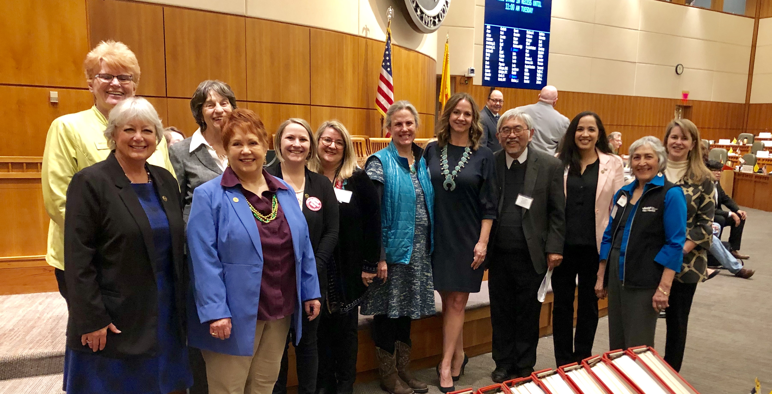

Slide 20
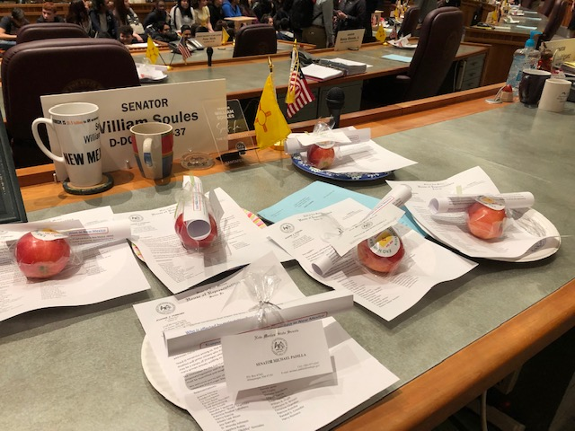
Notes:
End hunger day at the capitol. March 5th.

Slide 21
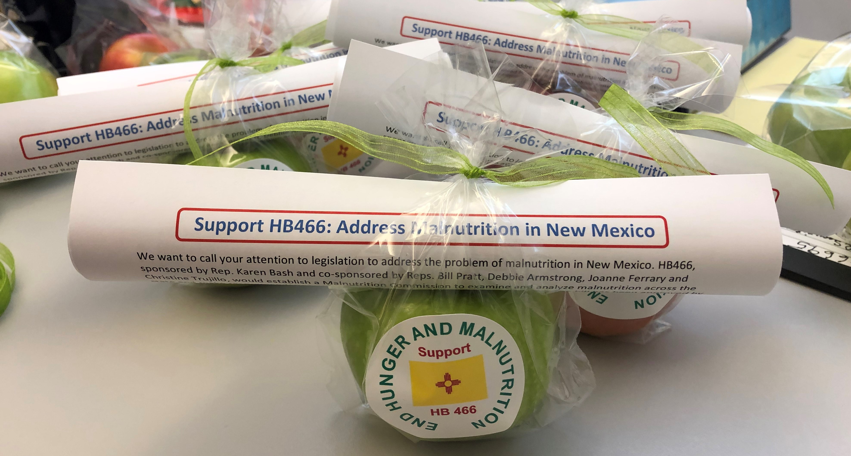

Slide 22
New Mexico HB 466
Senate Public Affairs Committee
DO PASS (3-2)
Full Senate Vote
17 - 25
FAILED TO PASS THE SENATE

Slide 23
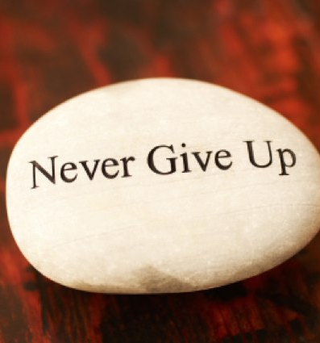
Lessons Learned and Next Steps
Support on the Health and Human Services committee and bringing together a coalition of support were key to moving the legislation forward
Advocates from across the State will come together with Legislative Leaders and develop next steps to establish the Malnutrition Commission
This Photo by Unknown Author is licensed under CC BY-SA-NC

Slide 24
Blueprint for Defeating Malnutrition
Philadelphia Corporation for Aging (PCA)

Slide 25
WHY WE GOT INVOLVED
Learned about DMT Campaign at N4a Conference 2017
Instantly knew PCA wanted to lead this campaign, why?
Bring awareness to the senior issue
Lack of association of hunger with seniors
Connect people to resources

Slide 26
STATISTICS WARRANT OUR INVOLVEMENT
271,658 Elderly in Philadelphia
23% are Considered Low Income (62,481)
1 in 2 Older Adults are at Risk
Numbers higher for Seniors in Health Care Settings

Slide 27
STATISTICS WARRANT OUR INVOLVEMENT
In Hospitals We Know
300% Increase in Healthcare Costs for those with Poor Nutritional Status
4 to 6 Days Longer in a Hospital
33% of Older Adults in Hospitals may be Malnourished
Sub Goal
Address Impact of Isolation on Seniors
The High Health Cost from Social Isolation in Elderly

Slide 28
PROCESS
Year One - Internal
Created PCA Committee
Every Department Represented
Mission Statement
The mission of the Defeat Malnutrition Today Philadelphia Coalition’s is to eliminate malnutrition among Philadelphia seniors through education, collaboration and advocacy.

Slide 29
PROCESS
Staff Awareness
I-Net
EBB
Articles
PCA Website

Slide 30
FIRST YEAR ACCOMPLISHMENT
Day Long Event – 04/20/18
Food Panel – Agencies We Work With
Philabundance
Shared Food Program
Coalition Against Hunger
Aid for Friends

Slide 31
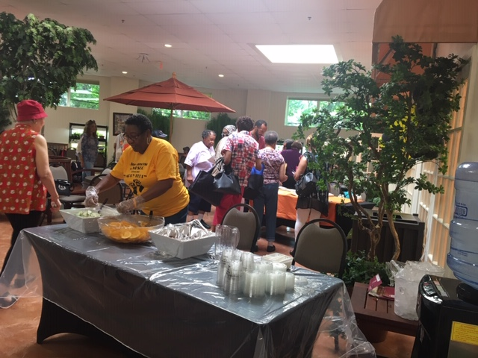
EVENTS AT SENIOR CENTERS
11 Home Grown Nutrition Programs Sponsored with Local Farmer’s Markets
Food Voucher Distributions
Food and Nutrition Demonstrations

Slide 32
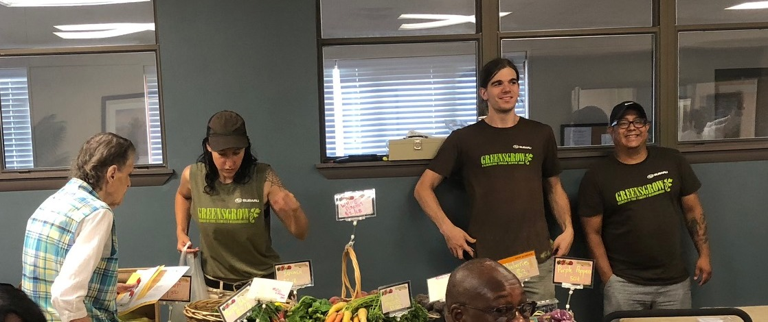
STAFF FOOD DRIVE
2019 MLK Day of Service
In Less than 2 weeks collected over 20 boxes of food equivalent to over 500 lbs.

Slide 33
YEAR TWO - EXTERNAL
Created and Expanded Coalition Membership
Date Set
March 19, 2019
124 Organizations Invited
Goal
Build a Network of Service Providers and Local Agencies Committed to the Mission and Goals

Slide 34
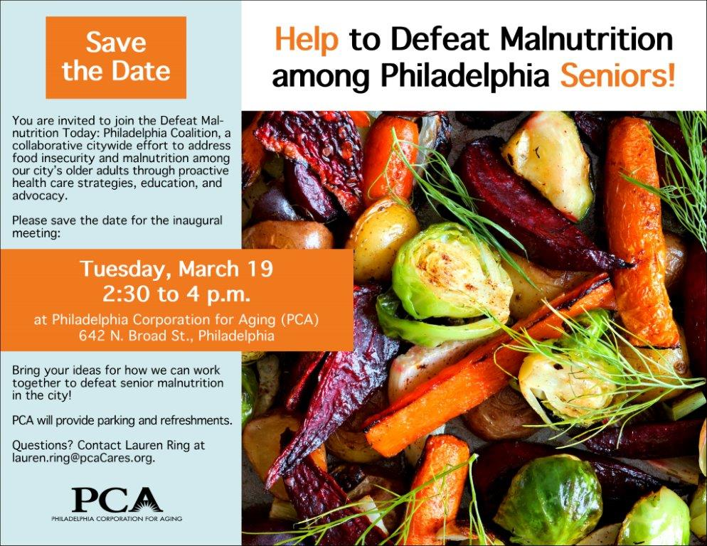

Slide 35
YEAR TWO -EXTERNAL
Attendees Included
3 - Government Agencies
11 - Hospitals/Acute Care Facilities
26 - Senior Centers
10 - Educational Institutions
1 - Housing Authority
5 - Aging Organizations
2 - Senior Law
3 - Community Mental Health
1 - Veterans

Slide 36
ADDITIONAL ATTENDEES INCLUDED
United Way
Salvation Army
3 - Grocery Stores
6 - MCO’s + Health Care Providers
Benefits Data Trust
Health Promotion
Council Pew Foundation
124 Invited
77 Attended
62% of Invitees

Slide 37
KEYNOTE SPEAKER BOB BLANCATO National Coordinator Director for Defeat Malnutrition Today
Goals and Strategies of the National Blueprint
Advancing Policies for Quality Malnutrition Care in Older Adults through State Actions
National Coalition and its Work

Slide 38
WHAT’S NEXT IN 2019?
A Discussion on Funding Challenges at the Federal Level
Concentrated work efforts within the 3 Sub Committees
Where the bulk of the work will be done
Awareness and Advocacy
Ensures that Malnutrition and Hunger among older adults is not overlooked by the media, government agencies or funders of programs and services
Advocate on behalf of older adults suffering from malnutrition or hunger

Slide 39
COMMUNITY LEVEL EDUCATION
To improve the ability of residents and community-based organizations to identify and refer elders suffering from hunger or malnutrition to resources that can help
Identify/compiling local resources and services
Helping to build innovative, locally tailored referral processes that can be used to help hard to reach elders

Slide 40
COMMUNITY LEVEL EDUCATION
Provide information to identify Malnutrition/Hunger among the elderly
How/Where To Get Screened
Philly Food Finder
PCA Senior Centers
MOW (Home Delivered Meals can cut the need for Hospital Care)
Creating Malnutrition Intervention/Referral Methods for Citywide use
Expand distribution sites for SFMNP Voucher Distribution Campaign

Slide 41
HEALTHCARE NETWORK
Improve ability of Healthcare Networks
To identify and refer Elders suffering from Hunger/Malnutrition to appropriate supportive services and other Non-Medical Resources
Train Hospital Gatekeepers
Each Subcommittee has 2 Co-Chairs and a Recording Secretary

Slide 42
03/19/19 First Large Event Huge Success

Slide 43
NEXT STEPS
Work with Committees to Identify
Goals/Projects
Define Success
Document Process
Replicability

Slide 44
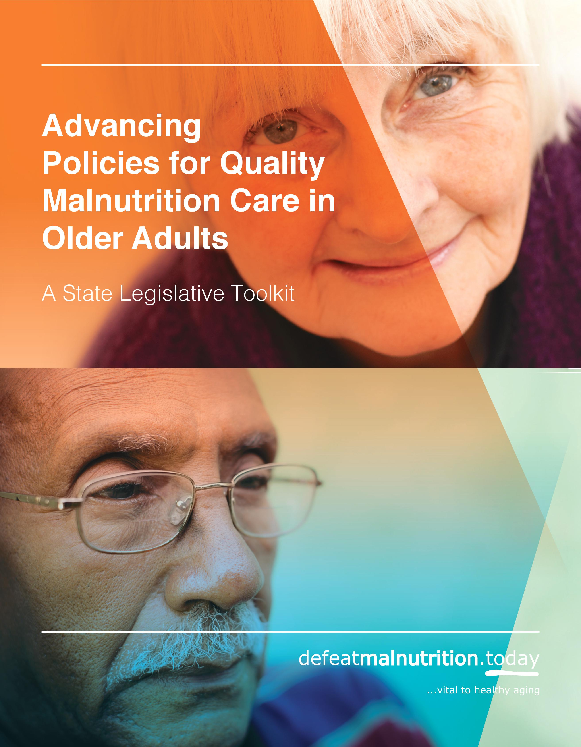
State Legislative Toolkit
Guide specifically for US state legislators
Includes sample resolutions, commission legislation, op-eds, social media, etc.
Also includes summary of the issue and its costs to states
http://bit.ly/state-toolkit

Slide 45
Conclusions/Looking Ahead
Need to keep raising awareness about malnutrition as a threat to older adults’ health—and a deterrent to active aging and maintaining independence
Also need to implement solutions at the local, state and national levels
Please use your influence at home to help us get more state legislation
Help us to Defeat Malnutrition Today! Check out our resources and join the coalition.

Slide 46
Resources
Defeat Malnutrition Today: http://defeatmalnutrition.today
National Blueprint and Blueprint Infographic: http://defeatmalnutrition.today/blueprint
State Legislative Toolkit: http://bit.ly/state-toolkit
State Malnutrition Infographic: http://bit.ly/state-infographic
Ohio Commission Report: http://bit.ly/ohio-report
mponder@matzblancato.com

Slide 47
Contact Us!
Meredith Whitmire
mponder@matzblancato.com
Stephanie Rogus
stephanie.rogus@gmail.com
Najja Orr
najja.orr@pcacares.org

